Slide 1



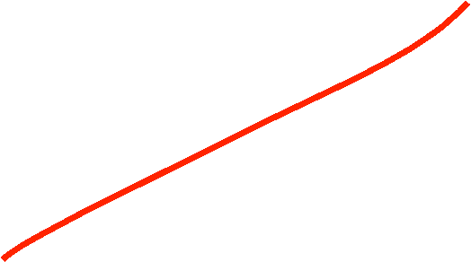




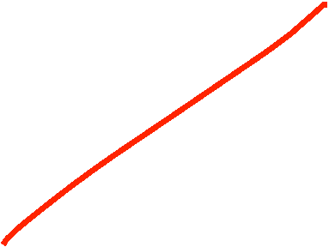
Lecture No 07

Slide 2




































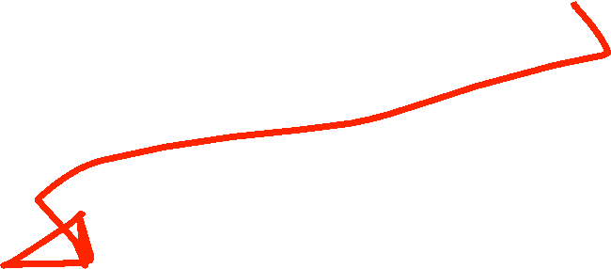















Slide 3


















































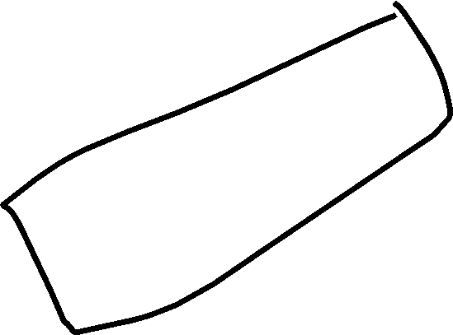





























Slide 4





















































































Slide 5





















































Slide 6





















Slide 7















































Slide 8








































Slide 9















Slide 10



































Slide 11











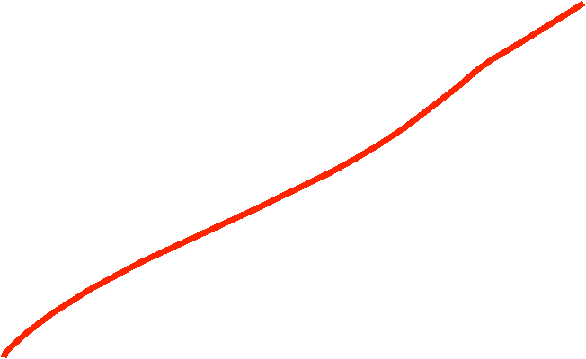



































Slide 12






























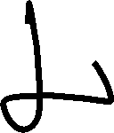











Slide 13



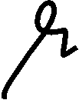

































































Slide 14










































Slide 15











































Slide 16










































Slide 17




































Slide 18



































Slide 19














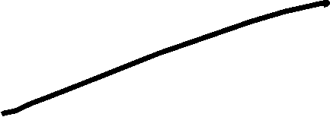

















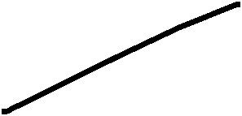

















Slide 20





















































Slide 21


















